Slide 1

ChowPal
Connecting Culture, Cooking, and Community
Ritujit Chaudhury | Rhea Roy | Prakriti Mishra | Shamsheer Hussain | Nehal Vaiti

Slide 2

Vision
“ChowPal bridges the gap between craving your grandmother's biryani and actually cooking it abroad. We connect international students with culturally authentic recipes, real-time ethnic grocery inventory, and a community of fellow home cooks, turning homesickness into home cooking.”

Slide 3




Unmet Needs
Real-time inventory visibility -
Students want to know what's in stock before traveling 45+ minutes.
Trusted, culturally authentic recipes -
Generic recipe sites lack credibility; community validation is critical.
Dietary accommodation -
Strong demand for halal, kosher, vegetarian filters within cultural cuisines.
Monetization for cultural knowledge -
Students want to earn from their cooking expertise but lack accessible platforms.

Slide 4




Customer Segments
ChowPal
Beginner Cook
Creators
Stores

Slide 5
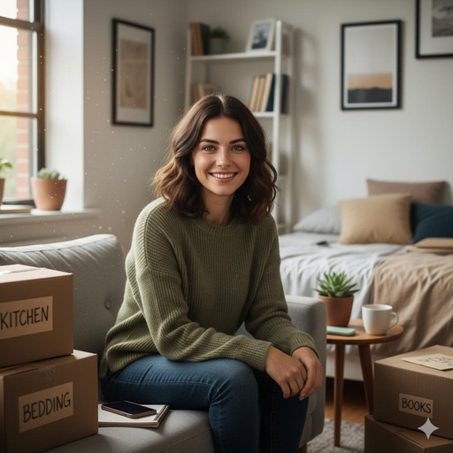

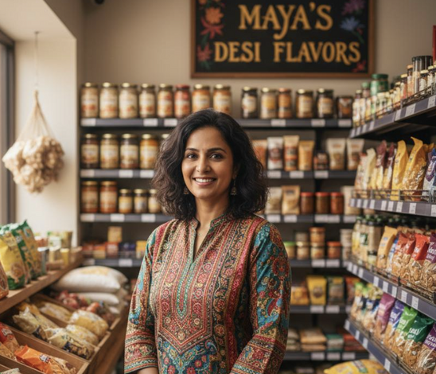
Use Cases
Aria, 25 yrs,
The Student Cook
Dev, 21 yrs,
The Recipe Creator
Maya, 39 yrs,
The Store Owner
“I just want to make dinner without running to three stores.”
“I love sharing my family recipes and seeing others try them.”
“I wish more students knew how to use the spices I sell.”

Slide 6



Competitive Analysis
Existing Solutions
Our Edge
Why Now?
• Recipe apps:
Ideas, no ingredient link.
• Grocery apps:
Delivery, no meal guidance.
• Meal kits:
Convenient but costly
• Social apps:
Inspiring, not practical.
• Built by international students.
• Cultural insight meets smart design.
• Authentic, affordable, community-driven.
• Home-cooking trend rising.
• AI enables smarter discovery.
• No bridge between recipes & shopping.

Slide 7
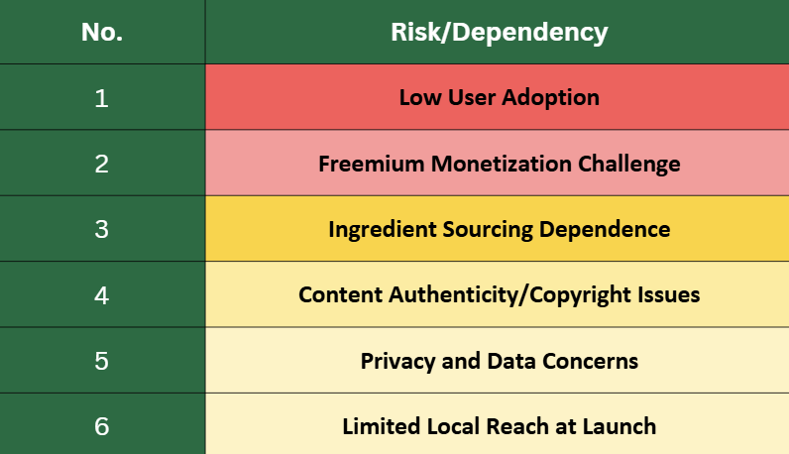
Risks
Decreasing Risk Level

Slide 8
Marketing Size and Opportunity
📊Total Addressable Market:
US Ethnic Grocery market: $10-15 B Annually.
Growth Rate: 8-12 CAGR.
🎯Target Market:
1.1 million International Students in U.S
300K+ Grad students off Campus
🚀Market Drivers:
Ethnic Grocery Delivery: Faster-growing food e-commerce.
Social Food Commerce: 150% Y-o-Y growth.
Intl’ students enrollment: 3-5% annual growth till 2030.
65% young adults are cooking more at home.
💡White Space:
No competitor combines recipe discovery, ethnic grocery, and creator monetization.
First-mover advantage in the current fragmented market.
ChowPal’s Opportunity
$1.3M
Year 1 Revenue Projection
<1%
Market Penetration
$166M
Grad Students Segment

